Slide 1
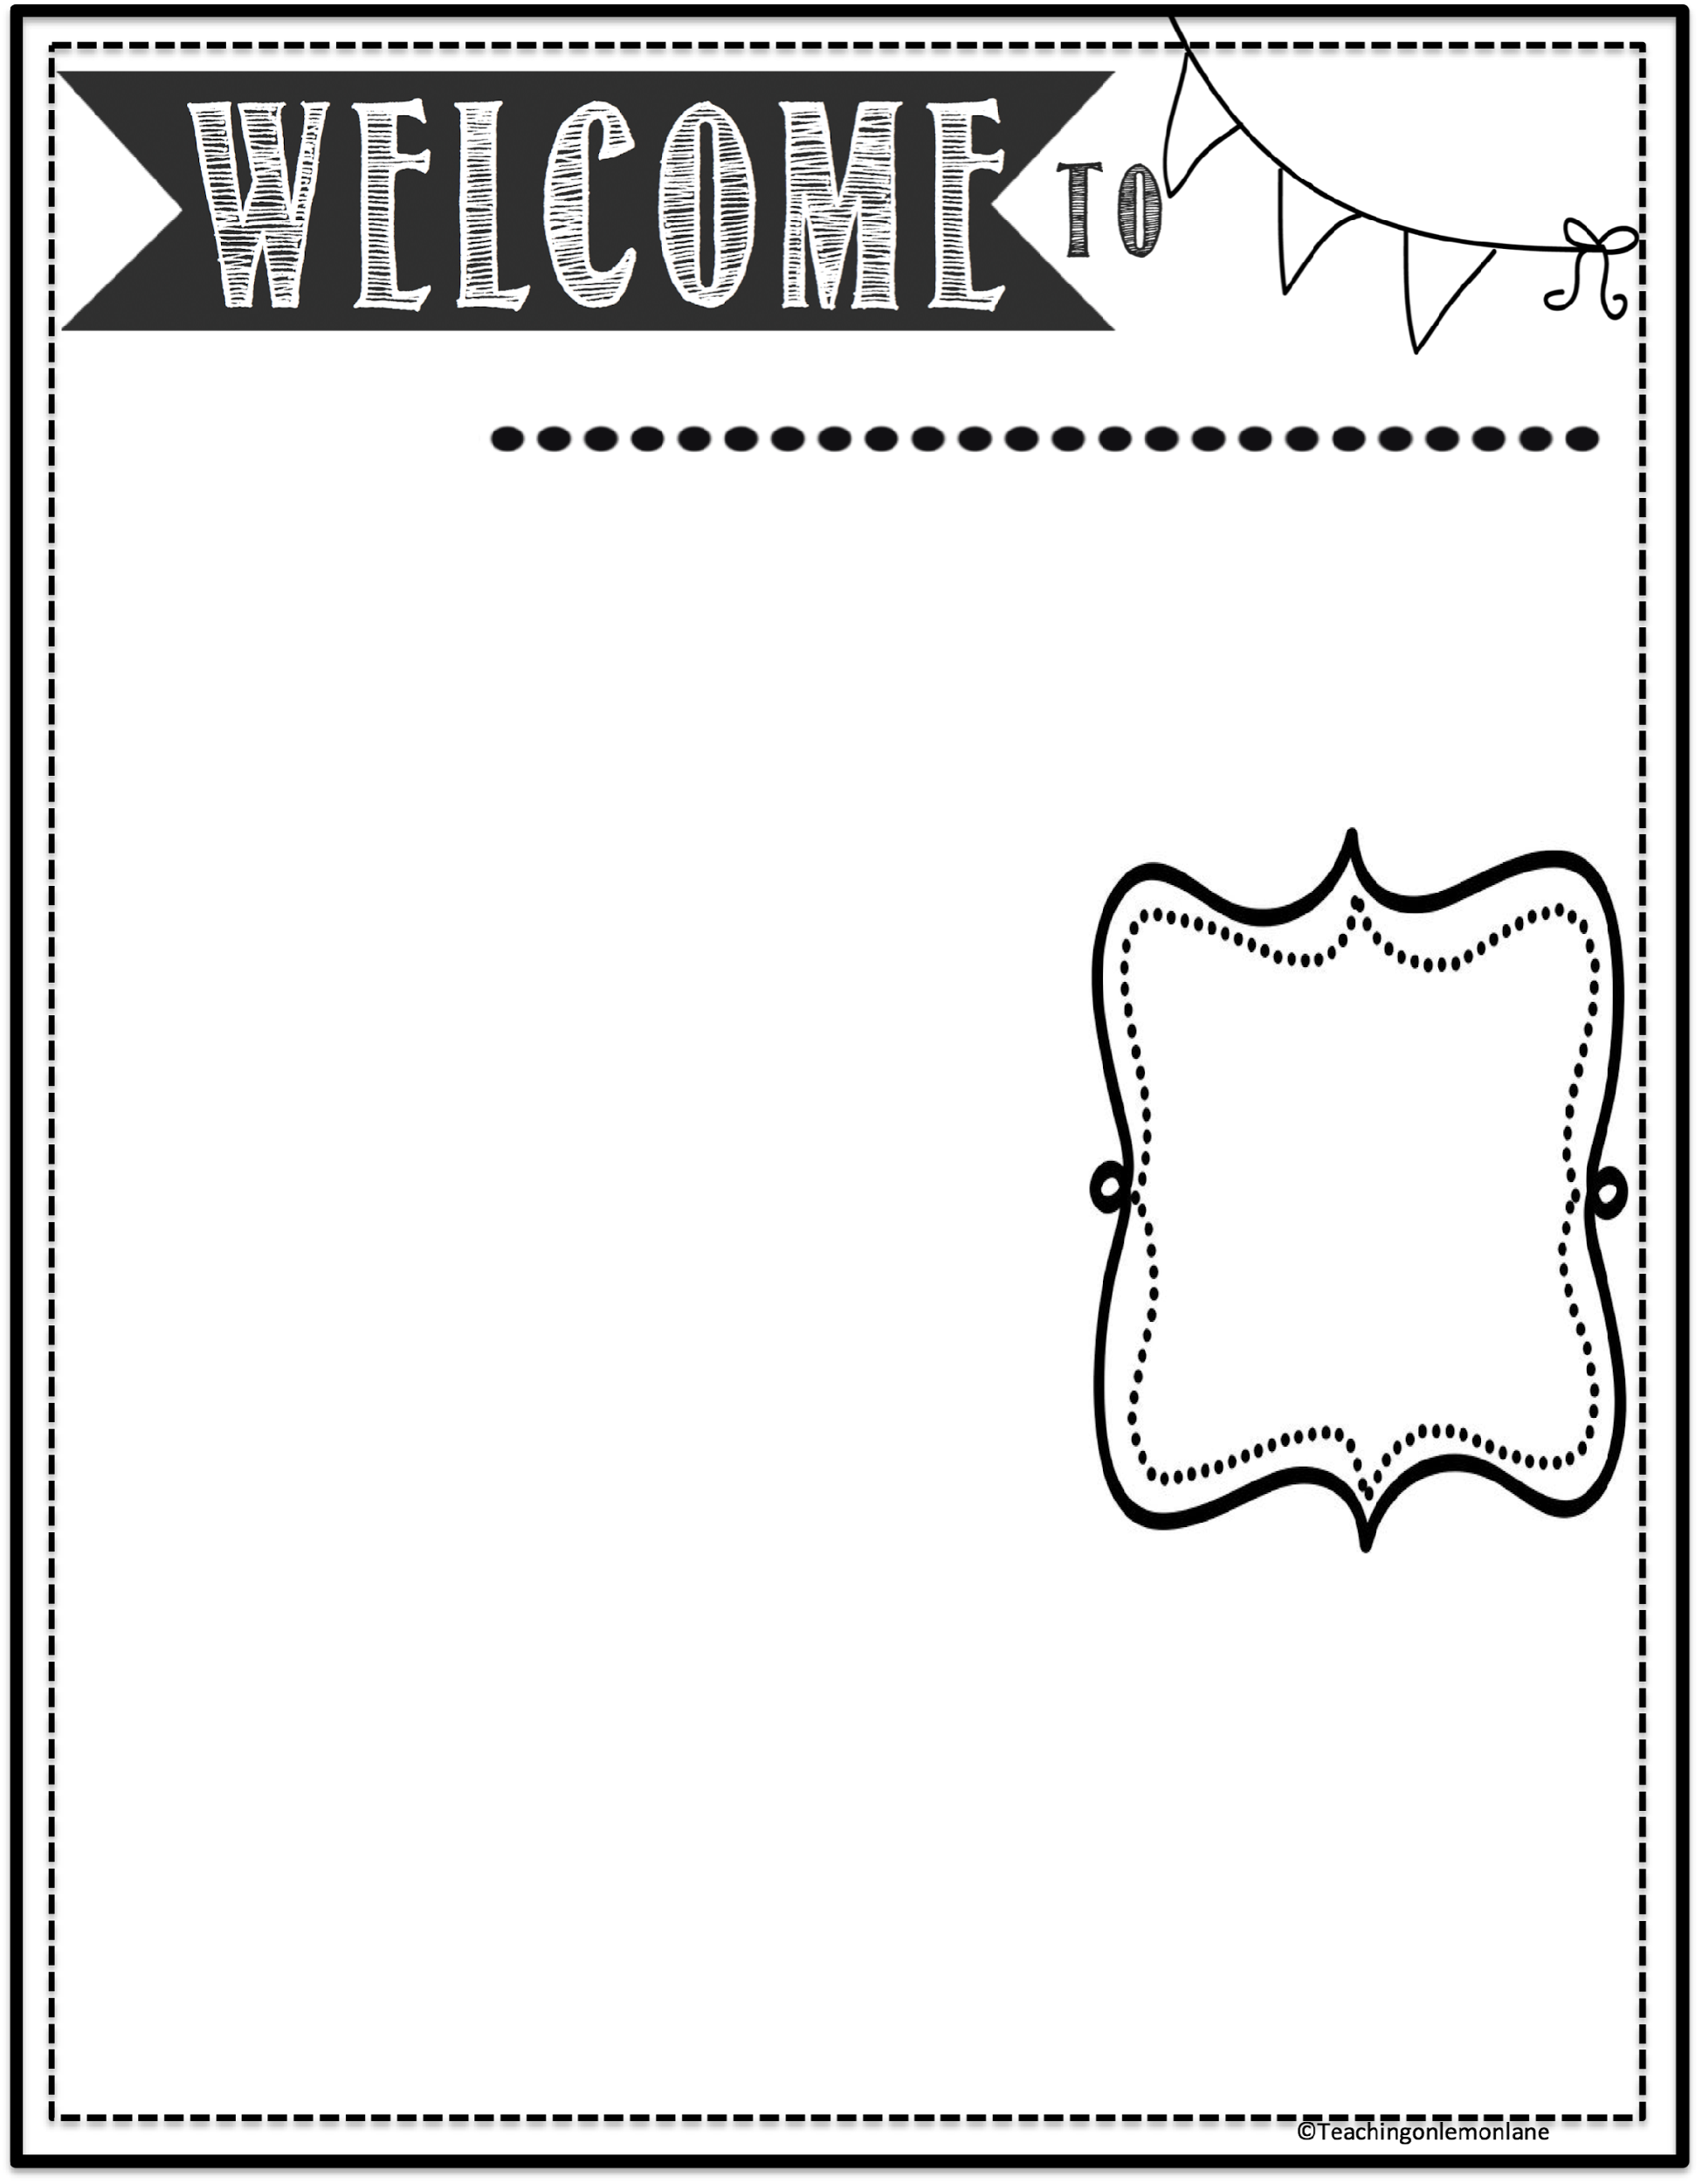
Everything you need to know
Mrs. Tolar’s Classroom
SCHEDULE
7:50 – 8:45 Env. Systems
8:49 – 9:37 Medical Terminology
9:41 – 10:30 Biology
10:34 – 11:21 8th Science
11:25 – 12:12 8th Science
12:16 – 1:03 Conference
1:06 - 1:36 HS Lunch
1:52 – 2:40 Biology
2:44 – 3:25 Env. Systems
Eighth Grade students are expected to follow these 3 rules:
Respect Yourself Respect Others Respect the School
Negative Consequences
Consequences will correspond with behavior. Each day is a new opportunity improve. If there is a constant or serious infraction I will email home to discuss a solution to the problem with your parent or guardian.
Positive Consequences
Inclusive classroom environment, positive praise, and special privileges.
CONTACT
jtolar@brookelandisd.net
Grading is based upon 60% classwork and 40% tests
I offer TUTORIALS every Tuesday and Thursday after school from 3:30 - 4:30 throughout the year.
Plagiarism and the use of AI will result in a failing
grade.
GRADING
Late Work:
1-3 days Late: 70%
4-5 days Late: 50%
6+ days Late: 0%
*Student learning is 1st priority
Missed Work: Students who miss work in class due to excused absences are permitted to make up that work prior to or within three school days from last absence. It is the student’s responsibility to check with each teacher for make-up work. Zeros will be given for work not made up. If a student missed check Google classroom for assignments. No extended time will be granted.
About Me
HOMEWORK
Students are expected to complete 3 tasks at home.
Go outside and play!
Complete assigned work (we will try to complete in class, but there will be some projects)
Tell me a good thing!!
Before I came to Brookeland ISD, I taught Junior High Science in Jasper for 5 years. Prior to teaching, I was a state park superintendent overseeing outdoor education as well as a former bat biologist (yes, that is a thing).
I have an undergraduate degree in Wildlife Conservation and Management and a masters degree in Zoology. I am a transplant to Texas from the Midwest and I love being here—with the exception of fire ants and a fear of alligators.
Visit: Google Classroom
Class Code: vwac2rnf

